Slide 1
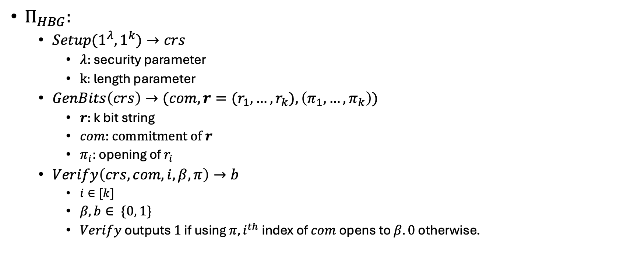
$Π_{HBG}:$
  ${Setup(1}^{λ}, 1^{k})→crs$
    $λ:$ security parameter
    $k:$ length parameter
  $GenBits\left(crs\right)→(com, r=(r_{1}, …, r_{k}), \left(π_{1}, …,π_{k}\right))$
    $r:$ k bit string
    $com:$ commitment of $r$
    $π_{i}:$ opening of $r_{i}$
  $Verify\left(crs, com, i, β, π\right)→b$
    $i∈[k]$
    $β, b∈ \{0, 1\}$
    $Verify$ outputs $1$ if using $π, i^{th}$ index of $com$ opens to $β. 0$ otherwise.

Slide 2
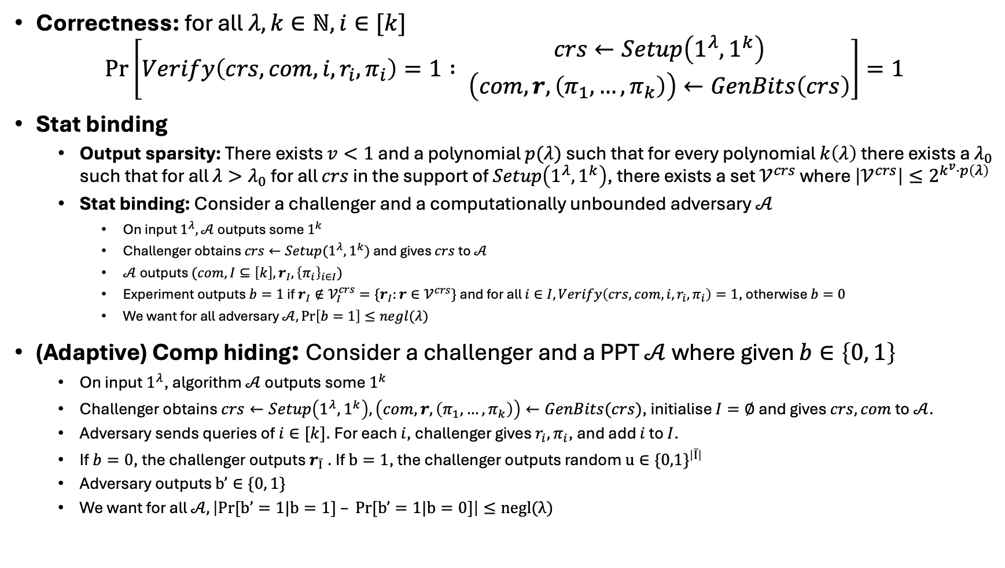
Correctness: for all $λ,k∈ℕ, i∈[k]$
$$\operatorname{Pr}\left[Verify\left(crs, com, i, r_{i},π_{i}\right)=1 : {crs←Setup\left(1^{λ},1^{k}\right) \atop \left(com, r, \left(π_{1}, …, π_{k}\right)\right)←GenBits\left(crs\right)}\right]=1$$
Stat binding
  Output sparsity: There exists $v<1$ and a polynomial $p(λ)$ such that for every polynomial $k\left(λ\right)$ there exists a $λ_{0}$ such that for all $λ>λ_{0}$ for all $crs$ in the support of $Setup\left(1^{λ}, 1^{k}\right)$, there exists a set $𝒱^{crs}$ where $\left|𝒱^{crs}\right|≤2^{k^{v}⋅p\left(λ\right)}$
  Stat binding: Consider a challenger and a computationally unbounded adversary $𝒜$
    On input $1^{λ}, 𝒜$ outputs some $1^{k}$
    Challenger obtains $crs←Setup(1^{λ},1^{k})$ and gives $crs$ to $𝒜$
    $𝒜$ outputs $(com, I⊆\left[k\right], r_{I},{\left\{π_{i}\right\}}_{i∈I})$
    Experiment outputs $b=1$ if $r_{I}∉𝒱_{I}^{crs}=\{r_{I}:r∈𝒱^{crs}\}$ and for all $i∈I, Verify\left(crs, com,i,r_{i},π_{i}\right)=1$, otherwise $b=0$
    We want for all adversary $𝒜,\operatorname{Pr}\left[b=1\right]≤negl(λ)$
(Adaptive) Comp hiding: Consider a challenger and a PPT $𝒜$ where given $b∈\left\{0, 1\right\}$
  On input $1^{λ}$, algorithm $𝒜$ outputs some $1^{k}$
  Challenger obtains $crs←Setup\left(1^{λ},1^{k}\right), \left(com, r, \left(π_{1},…,π_{k}\right)\right)←GenBits(crs)$, initialise $I=∅$ and gives $crs, com$ to $𝒜$.
  Adversary sends queries of $i∈[k]$. For each $i$, challenger gives $r_{i}, π_{i}$, and add $i$ to $I$.
  If $b=0$, the challenger outputs $r_{\overline{I}}$. If $b=1$, the challenger outputs random $u∈{\{0,1\}}^{\left|\overline{I}\right|}$
  Adversary outputs $b’∈\{0, 1\}$
  We want for all $𝒜, \left|Pr[b’=1|b=1] – Pr[b’=1|b=0]\right|≤negl(λ)$

Slide 3
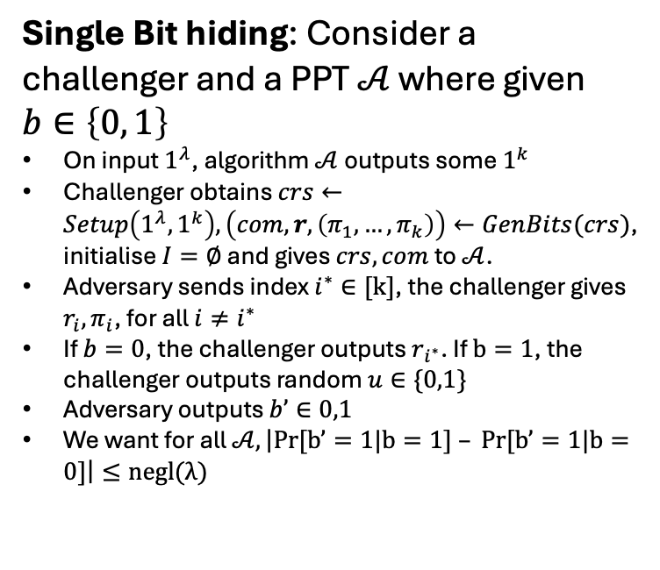
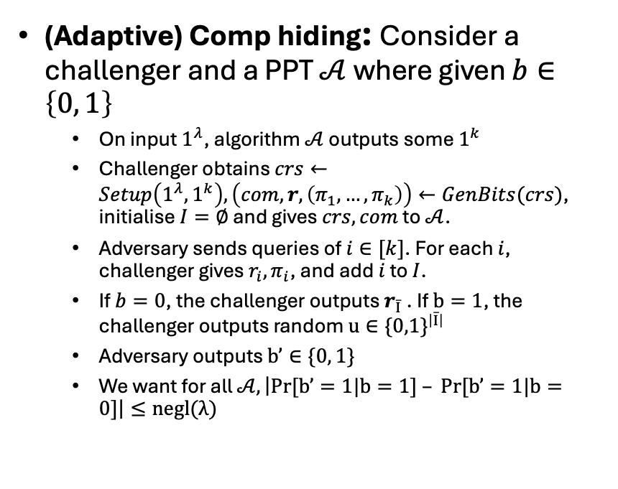
(Adaptive) Comp hiding: Consider a challenger and a PPT $𝒜$ where given $b∈\left\{0, 1\right\}$
  On input $1^{λ}$, algorithm $𝒜$ outputs some $1^{k}$
  Challenger obtains $crs←Setup\left(1^{λ},1^{k}\right), \left(com, r, \left(π_{1},…,π_{k}\right)\right)←GenBits(crs)$, initialise $I=∅$ and gives $crs, com$ to $𝒜$.
  Adversary sends queries of $i∈[k]$. For each $i$, challenger gives $r_{i}, π_{i}$, and add $i$ to $I$.
  If $b=0$, the challenger outputs $r_{\overline{I}}$. If $b=1$, the challenger outputs random $u∈{\{0,1\}}^{\left|\overline{I}\right|}$
  Adversary outputs $b’∈\{0, 1\}$
  We want for all $𝒜, \left|Pr[b’=1|b=1] – Pr[b’=1|b=0]\right|≤negl(λ)$
Single Bit hiding: Consider a challenger and a PPT $𝒜$ where given $b∈\left\{0, 1\right\}$
On input $1^{λ}$, algorithm $𝒜$ outputs some $1^{k}$
Challenger obtains $crs←Setup\left(1^{λ},1^{k}\right), \left(com, r, \left(π_{1},…,π_{k}\right)\right)←GenBits(crs)$, initialise $I=∅$ and gives $crs, com$ to $𝒜$.
Adversary sends index $i^{∗}∈[k]$, the challenger gives $r_{i}, π_{i}$, for all $i≠i^{∗}$
If $b=0$, the challenger outputs $r_{i^{∗}}$. If $b=1$, the challenger outputs random $u∈\{0,1\}$
Adversary outputs $b’∈0,1$
We want for all $𝒜, \left|Pr[b’=1|b=1] – Pr[b’=1|b=0]\right|≤negl(λ)$

Slide 4
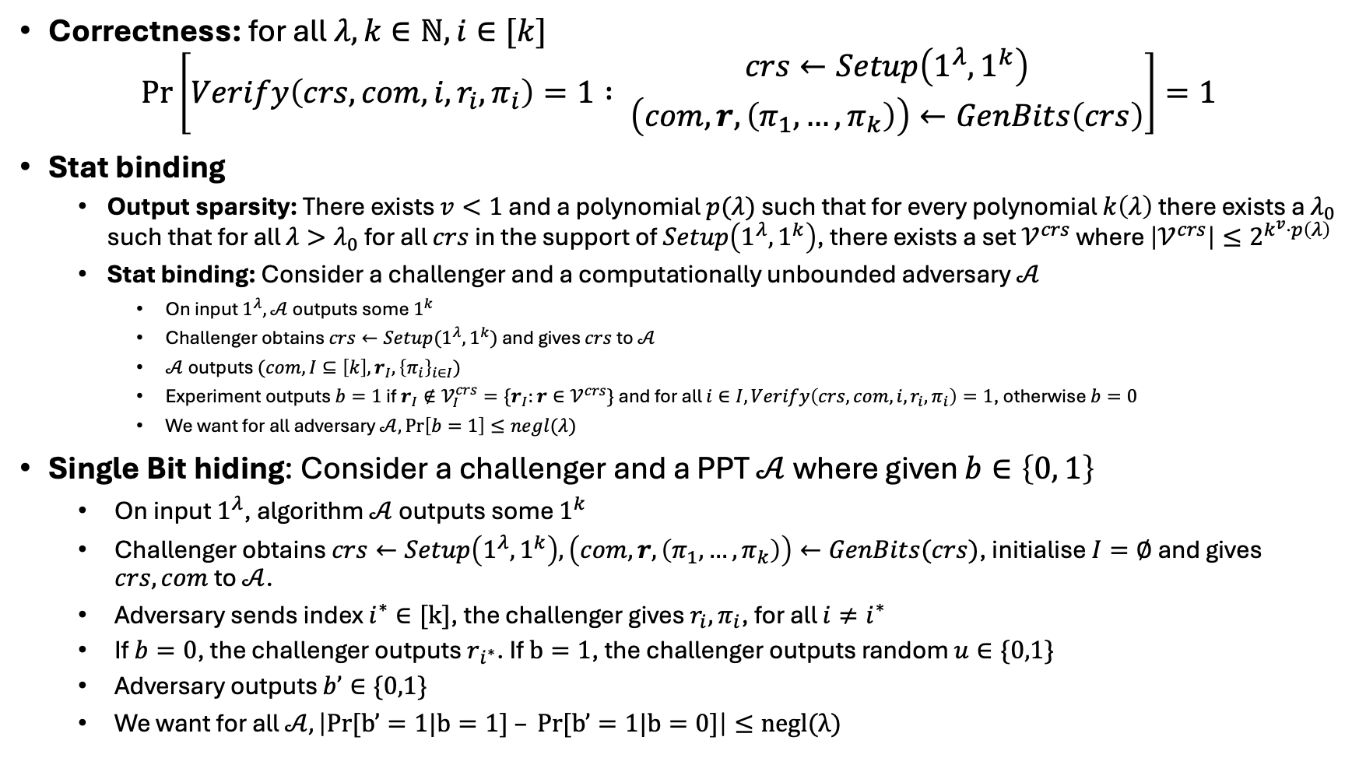
Correctness: for all $λ,k∈ℕ, i∈[k]$
$$\operatorname{Pr}\left[Verify\left(crs, com, i, r_{i},π_{i}\right)=1 : {crs←Setup\left(1^{λ},1^{k}\right) \atop \left(com, r, \left(π_{1}, …, π_{k}\right)\right)←GenBits\left(crs\right)}\right]=1$$
Stat binding
  Output sparsity: There exists $v<1$ and a polynomial $p(λ)$ such that for every polynomial $k\left(λ\right)$ there exists a $λ_{0}$ such that for all $λ>λ_{0}$ for all $crs$ in the support of $Setup\left(1^{λ}, 1^{k}\right)$, there exists a set $𝒱^{crs}$ where $\left|𝒱^{crs}\right|≤2^{k^{v}⋅p\left(λ\right)}$
  Stat binding: Consider a challenger and a computationally unbounded adversary $𝒜$
    On input $1^{λ}, 𝒜$ outputs some $1^{k}$
    Challenger obtains $crs←Setup(1^{λ},1^{k})$ and gives $crs$ to $𝒜$
    $𝒜$ outputs $(com, I⊆\left[k\right], r_{I},{\left\{π_{i}\right\}}_{i∈I})$
    Experiment outputs $b=1$ if $r_{I}∉𝒱_{I}^{crs}=\{r_{I}:r∈𝒱^{crs}\}$ and for all $i∈I, Verify\left(crs, com,i,r_{i},π_{i}\right)=1$, otherwise $b=0$
    We want for all adversary $𝒜,\operatorname{Pr}\left[b=1\right]≤negl(λ)$
Single Bit hiding: Consider a challenger and a PPT $𝒜$ where given $b∈\left\{0, 1\right\}$
  On input $1^{λ}$, algorithm $𝒜$ outputs some $1^{k}$
  Challenger obtains $crs←Setup\left(1^{λ},1^{k}\right), \left(com, r, \left(π_{1},…,π_{k}\right)\right)←GenBits(crs)$, initialise $I=∅$ and gives $crs, com$ to $𝒜$.
  Adversary sends index $i^{∗}∈[k]$, the challenger gives $r_{i}, π_{i}$, for all $i≠i^{∗}$
  If $b=0$, the challenger outputs $r_{i^{∗}}$. If $b=1$, the challenger outputs random $u∈\{0,1\}$
  Adversary outputs $b’∈\{0,1\}$
  We want for all $𝒜, \left|Pr[b’=1|b=1] – Pr[b’=1|b=0]\right|≤negl(λ)$

Slide 5
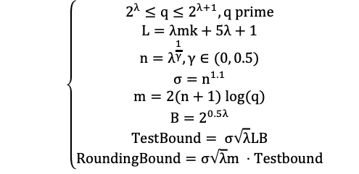
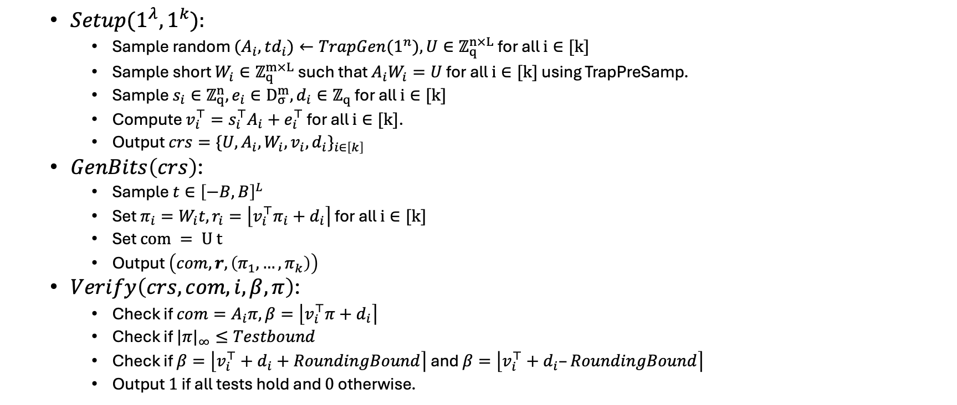
  $$\left\{\begin{aligned}2^{λ}≤q≤2^{λ+1}, q prime \\ L=λmk+5λ+1 \\ n=λ^{\frac{1}{γ}}, γ∈(0, 0.5) \\ σ=n^{1.1} \\ m=2(n+1) log(q) \\ B=2^{0.5λ} \\ TestBound= σ\sqrt{λ}LB \\ RoundingBound=σ\sqrt{λ}m ⋅Testbound\end{aligned}\right.$$
  ${Setup(1}^{λ}, 1^{k}):$
    Sample random ${(A}_{i},td_{i})←TrapGen(1^{n}), U∈ℤ_{q}^{n×L}$ for all $i∈[k]$
    Sample short $W_{i}∈ℤ_{q}^{m×L}$ such that $A_{i}W_{i}=U$ for all $i∈[k]$ using TrapPreSamp.
    Sample $s_{i}∈ℤ_{q}^{n},e_{i}∈D_{σ}^{m},d_{i}∈ℤ_{q}$ for all $i∈[k]$
    Compute $v_{i}^{⊤}=s_{i}^{⊤}A_{i}+e_{i}^{⊤}$ for all $i∈[k]$.
    Output $crs=\{U,A_{i},W_{i},v_{i},d_{i}\}_{i∈\left[k\right]}$
  $GenBits\left(crs\right)$:
    Sample $t∈{\left[−B,B\right]}^{L}$
    Set $π_{i}=W_{i}t,r_{i}=\left\lfloor v_{i}^{⊤}π_{i}+d_{i}\right\rceil$ for all $i∈[k]$
    Set $com = U t$
    Output $\left(com,r,\left(π_{1},…,π_{k}\right)\right)$
  $Verify\left(crs, com, i, β, π\right)$:
    Check if $com=A_{i}π,β=\left\lfloor v_{i}^{⊤}π+d_{i}\right\rceil$
    Check if $|π|_{∞}≤Testbound$
    Check if $β=\left\lfloor v_{i}^{⊤}+d_{i}+RoundingBound\right\rceil$ and $β=\left\lfloor v_{i}^{⊤}+d_{i}–RoundingBound\right\rceil$
    Output $1$ if all tests hold and $0$ otherwise.

Slide 6
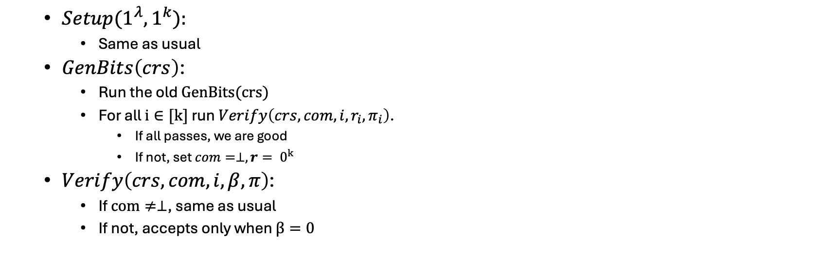
  ${Setup(1}^{λ}, 1^{k}):$
    Same as usual
  $GenBits\left(crs\right)$:
    Run the old $GenBits(crs)$
    For all $i∈[k]$ run $Verify\left(crs,com,i,r_{i},π_{i}\right)$.
      If all passes, we are good
      If not, set $com=⊥, r= 0^{k}$
  $Verify\left(crs, com, i, β, π\right)$:
    If $com≠⊥$, same as usual
    If not, accepts only when $β=0$

Slide 7
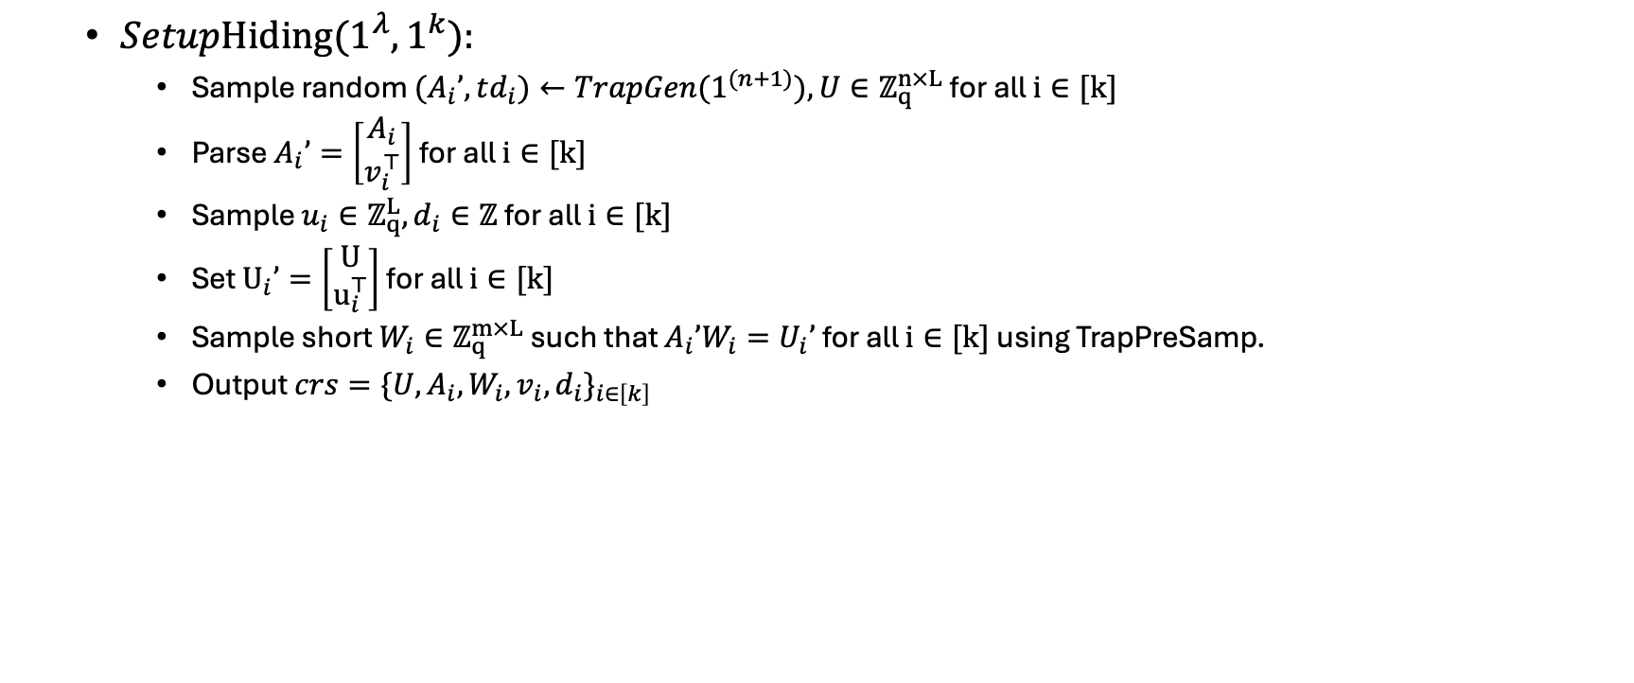
  ${SetupHiding(1}^{λ}, 1^{k}):$
    Sample random ${(A}_{i}’,td_{i})←TrapGen(1^{(n+1)}), U∈ℤ_{q}^{n×L}$ for all $i∈[k]$
    Parse $A_{i}’=\left[\begin{matrix}A_{i} \\ v_{i}^{⊤}\end{matrix}\right]$ for all $i∈[k]$
    Sample $u_{i}∈ℤ_{q}^{L},d_{i}∈ℤ$ for all $i∈[k]$
    Set $U_{i}’=\left[\begin{matrix}U \\ u_{i}^{⊤}\end{matrix}\right]$ for all $i∈[k]$
    Sample short $W_{i}∈ℤ_{q}^{m×L}$ such that $A_{i}’W_{i}=U_{i}’$ for all $i∈[k]$ using TrapPreSamp.
    Output $crs=\{U,A_{i},W_{i},v_{i},d_{i}\}_{i∈\left[k\right]}$

Slide 8
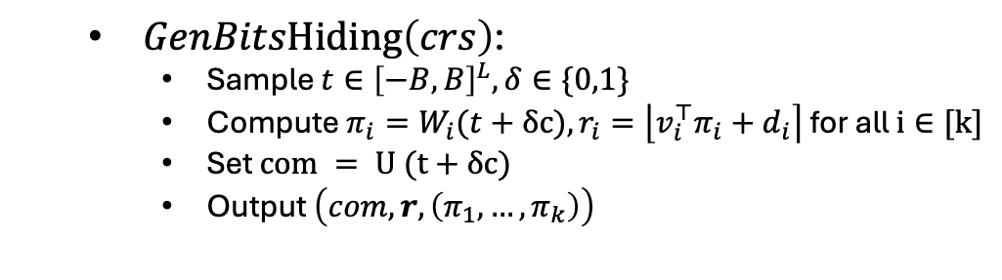
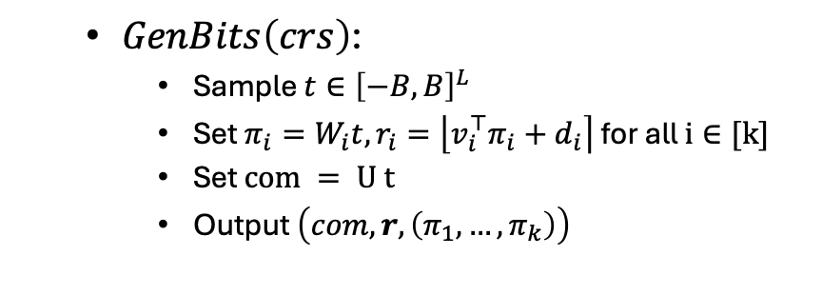
  $GenBits\left(crs\right)$:
    Sample $t∈{\left[−B,B\right]}^{L}$
    Set $π_{i}=W_{i}t,r_{i}=\left\lfloor v_{i}^{⊤}π_{i}+d_{i}\right\rceil$ for all $i∈[k]$
    Set $com = U t$
    Output $\left(com,r,\left(π_{1},…,π_{k}\right)\right)$
  $GenBitsHiding\left(crs\right)$:
    Sample $t∈{\left[−B,B\right]}^{L},δ∈\{0,1\}$
    Compute $π_{i}=W_{i}(t+δc),r_{i}=\left\lfloor v_{i}^{⊤}π_{i}+d_{i}\right\rceil$ for all $i∈[k]$
    Set $com = U (t+δc)$
    Output $\left(com,r,\left(π_{1},…,π_{k}\right)\right)$

Slide 9
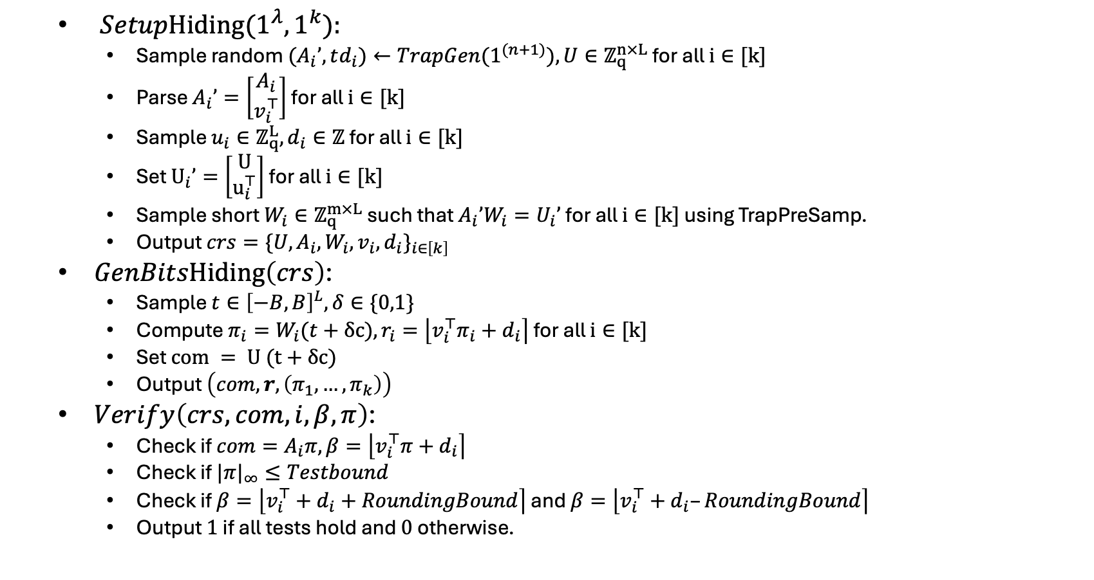
  ${SetupHiding(1}^{λ}, 1^{k}):$
    Sample random ${(A}_{i}’,td_{i})←TrapGen(1^{(n+1)}), U∈ℤ_{q}^{n×L}$ for all $i∈[k]$
    Parse $A_{i}’=\left[\begin{matrix}A_{i} \\ v_{i}^{⊤}\end{matrix}\right]$ for all $i∈[k]$
    Sample $u_{i}∈ℤ_{q}^{L},d_{i}∈ℤ$ for all $i∈[k]$
    Set $U_{i}’=\left[\begin{matrix}U \\ u_{i}^{⊤}\end{matrix}\right]$ for all $i∈[k]$
    Sample short $W_{i}∈ℤ_{q}^{m×L}$ such that $A_{i}’W_{i}=U_{i}’$ for all $i∈[k]$ using TrapPreSamp.
    Output $crs=\{U,A_{i},W_{i},v_{i},d_{i}\}_{i∈\left[k\right]}$
  $GenBitsHiding\left(crs\right)$:
    Sample $t∈{\left[−B,B\right]}^{L},δ∈\{0,1\}$
    Compute $π_{i}=W_{i}(t+δc),r_{i}=\left\lfloor v_{i}^{⊤}π_{i}+d_{i}\right\rceil$ for all $i∈[k]$
    Set $com = U (t+δc)$
    Output $\left(com,r,\left(π_{1},…,π_{k}\right)\right)$
  $Verify\left(crs, com, i, β, π\right)$:
    Check if $com=A_{i}π,β=\left\lfloor v_{i}^{⊤}π+d_{i}\right\rceil$
    Check if $|π|_{∞}≤Testbound$
    Check if $β=\left\lfloor v_{i}^{⊤}+d_{i}+RoundingBound\right\rceil$ and $β=\left\lfloor v_{i}^{⊤}+d_{i}–RoundingBound\right\rceil$
    Output $1$ if all tests hold and $0$ otherwise.

